Slide 1
Grammar B1 defining relative clauses
Recommended for:
Gold Experience
Focus
High Note
2019

Slide 2
We can use defining relative clauses to describe a person, place, thing, etc. We do this to make it clear what we are referring to.
Let’s look at:
When we use defining relative clauses.
Relative pronouns and how to use them.
When do we use them?

Slide 3
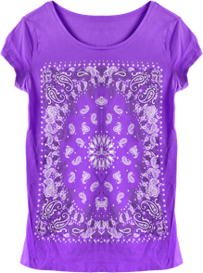
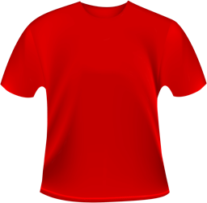
Function: When do we use them?
defining relative clauses
I bought the cheapest t-shirt which was red.
£10
£20
£30
In the sentence above, which was red is a defining relative clause.
No.
Because it is purple, not red.
So, is the relative clause which was red necessary to understand which t-shirt the girl bought?
Did the girl buy the cheapest
t-shirt?
How do you know?
Yes because she didn’t buy the cheapest t-shirt (the purple one). She bought the cheapest of the two red t-shirts.

Slide 4
Function: When do we use them?
Defining relative clauses give information which is necessary to tell us which object, person, place, etc. we are talking about.
I bought the cheapest t-shirt which was red.
£10
£20
£30
Here, the relative clause, which was red, is necessary. She didn’t buy the cheapest t-shirt
(the purple one).
This is the cheapest t-shirt.
This is the cheapest t-shirt which is red.
Defining relative clauses have no comma before them.
Relative pronouns…

Slide 5
Function: What about relative pronouns?
Relative pronouns connect the relative clause to the rest of the sentence. We use different relative pronouns depending what we are describing.
Look at the examples and complete the table with one of the relative pronouns in bold.
people
things/animals
places
possession
who
which
where
whose
It’s the restaurant where I had my birthday party.
He’s the boy who I walk to school with.
It’s the dog whose owner is sitting over there.
I read a wonderful book which was set in New York.

Slide 6
Function: What about relative pronouns?
Relative pronouns connect the relative clause to the rest of the sentence. We use different relative pronouns depending what we are describing.
It’s the restaurant where I had my birthday party.
He’s the boy who I walk to school with.
It’s the dog whose owner is sitting over there.
I read a wonderful book which was set in New York.
In defining relative clauses, we can also use that instead of who or which.
people | who
things/animals | which
places | where
possession | whose
In defining relative clauses, we can omit the relative pronouns who, which or that when the relative pronoun is the object of the clause, not the subject. Look…
He’s the boy who I walk to school with.
He’s the boy I walk to school with.
I read a book which was set in NYC.
I read a book was set in NYC.
the boy is the object of the clause here, so it can be omitted:
I walk to school with the boy.
The book is the subject of the clause here, so it can’t be omitted:
The book was set in NYC.
We never make relative pronouns plural, e.g. whos, whiches.
subject
verb
object
subject
verb

Slide 7
Practice activities
Find and correct the errors in these sentences.
who/that
She’s the girl which I saw at the concert last month.
That’s the bike my parents have bought me for my birthday.
That’s the car was in the police chase last week in the town centre.
That’s the dog who owner works in the shop next to our house. I think it’s lost!
Do you want a telephone that has a good camera?
Those are the sweets whiches we got for the class party.
which/that
whose
which/that

Slide 8
Image credits
The publisher would like to thank the following for their kind permission to reproduce their images:
123RF.com: robisklp; Shutterstock.com: Gemenacom, Tarzhanova

